Slide 1
Algorithms

Slide 2
Minimum Spanning Tree
Prim’s and Kruskal’s Algorithm

Slide 3
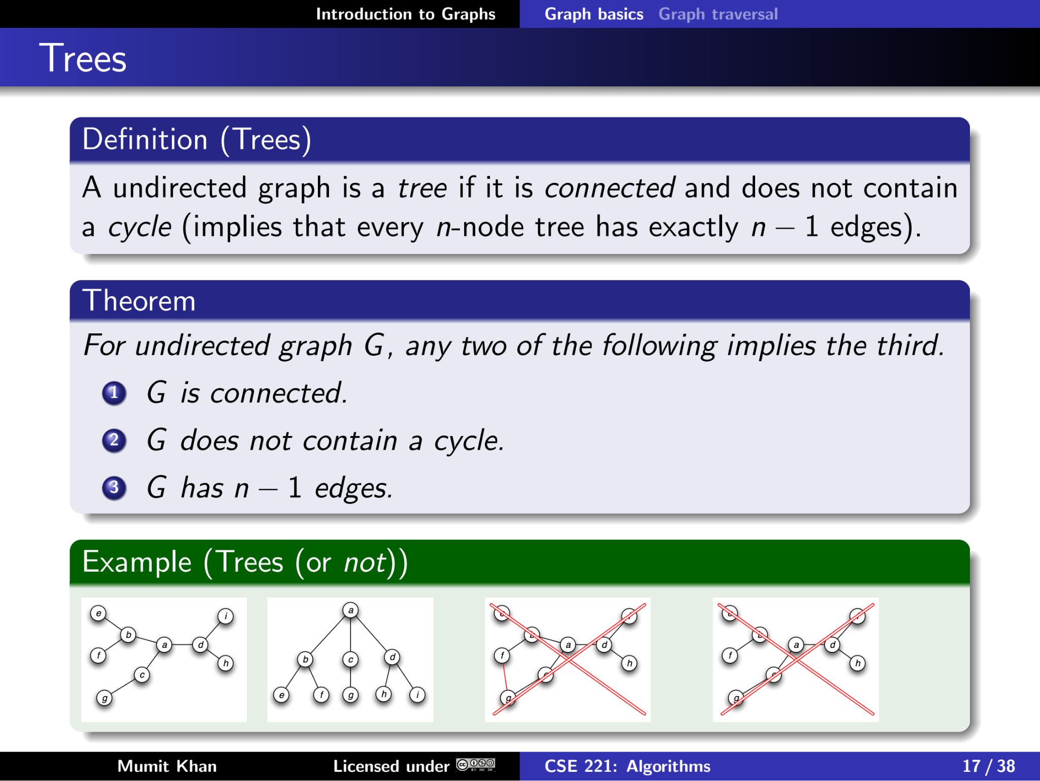
Recall

Slide 4
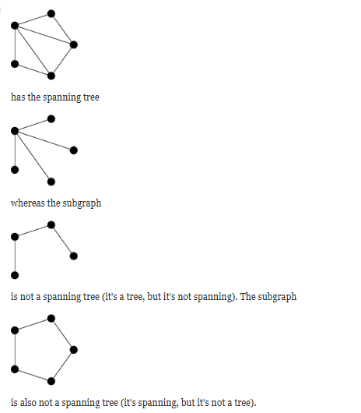
Difference Between Tree and Spanning Tree
A tree is a type of graph. A spanning tree is a subgraph of the graph that is a tree and hits every vertex.
This graph:

Slide 5
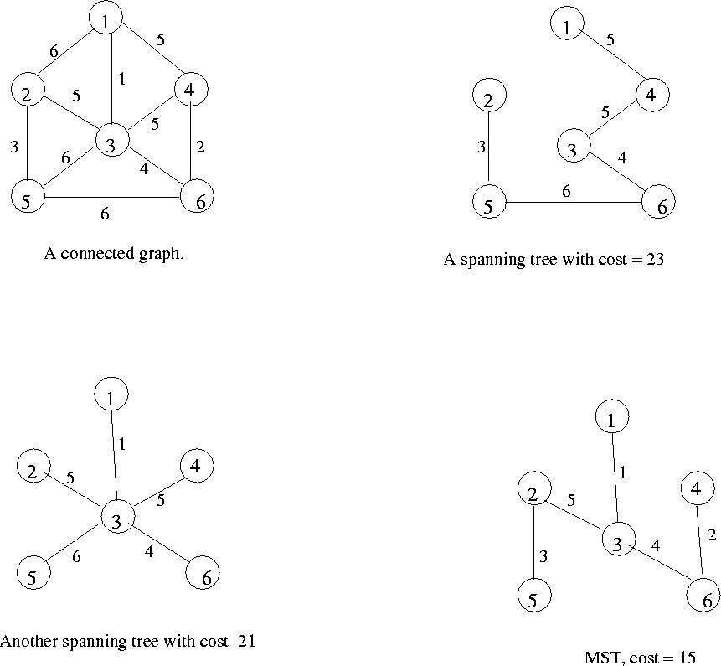
Minimum Spanning Tree (MST)
Minimum spanning tree is the spanning tree where the cost is minimum among all the spanning trees.

Slide 6
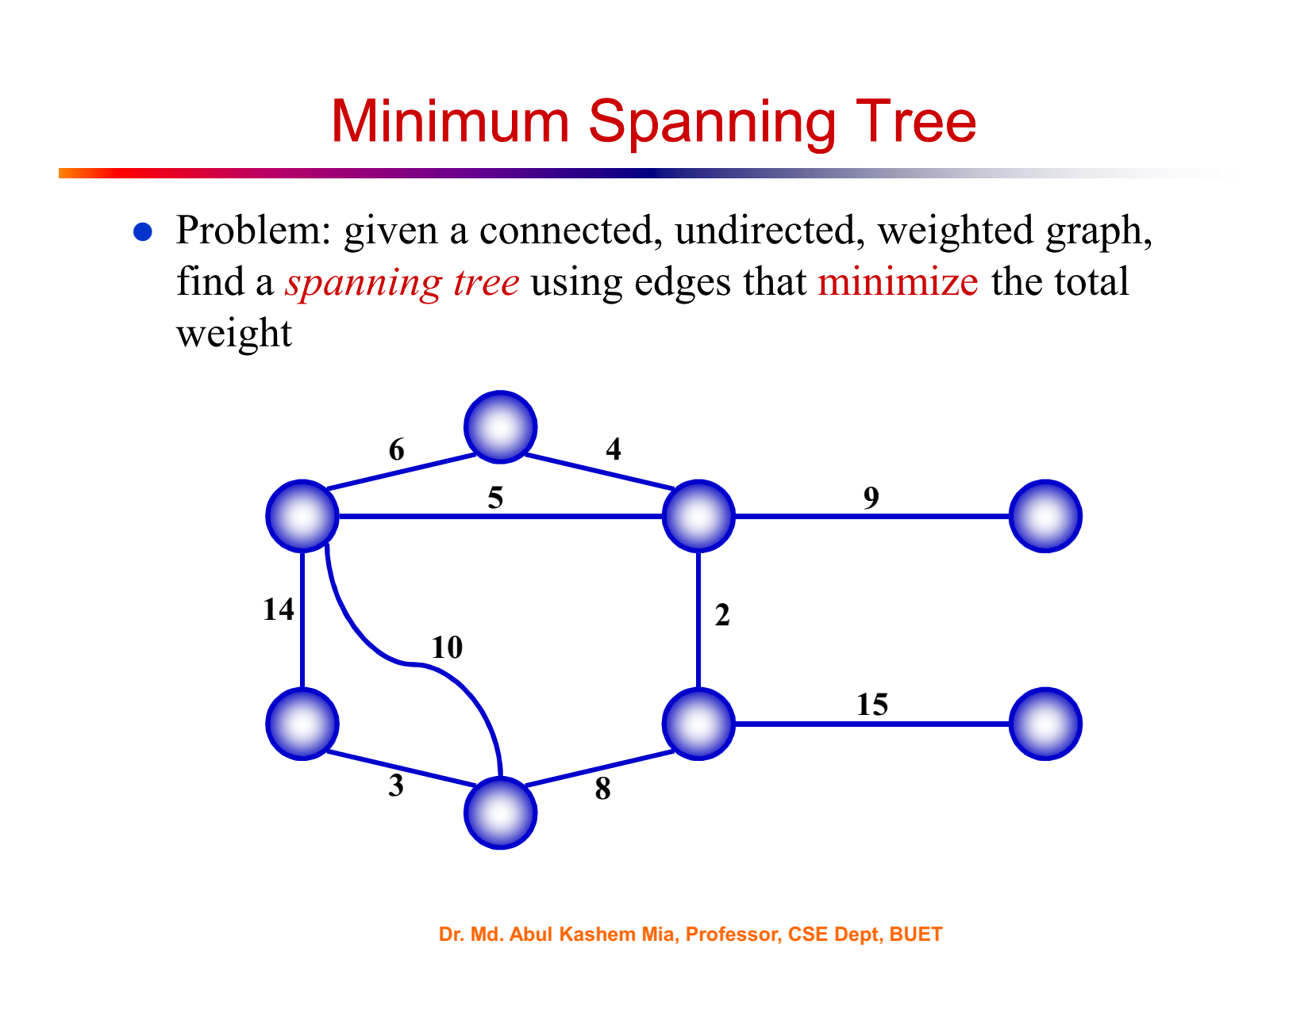

Slide 7
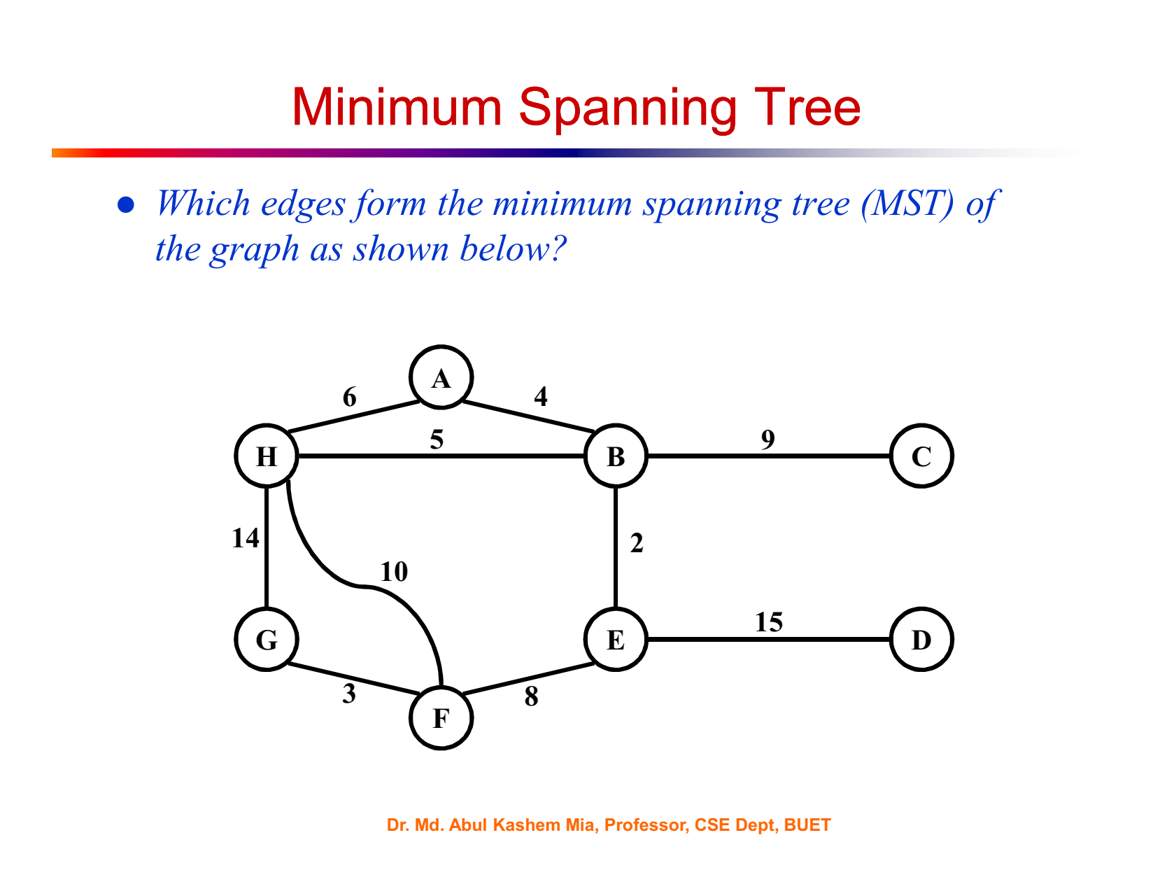

Slide 8
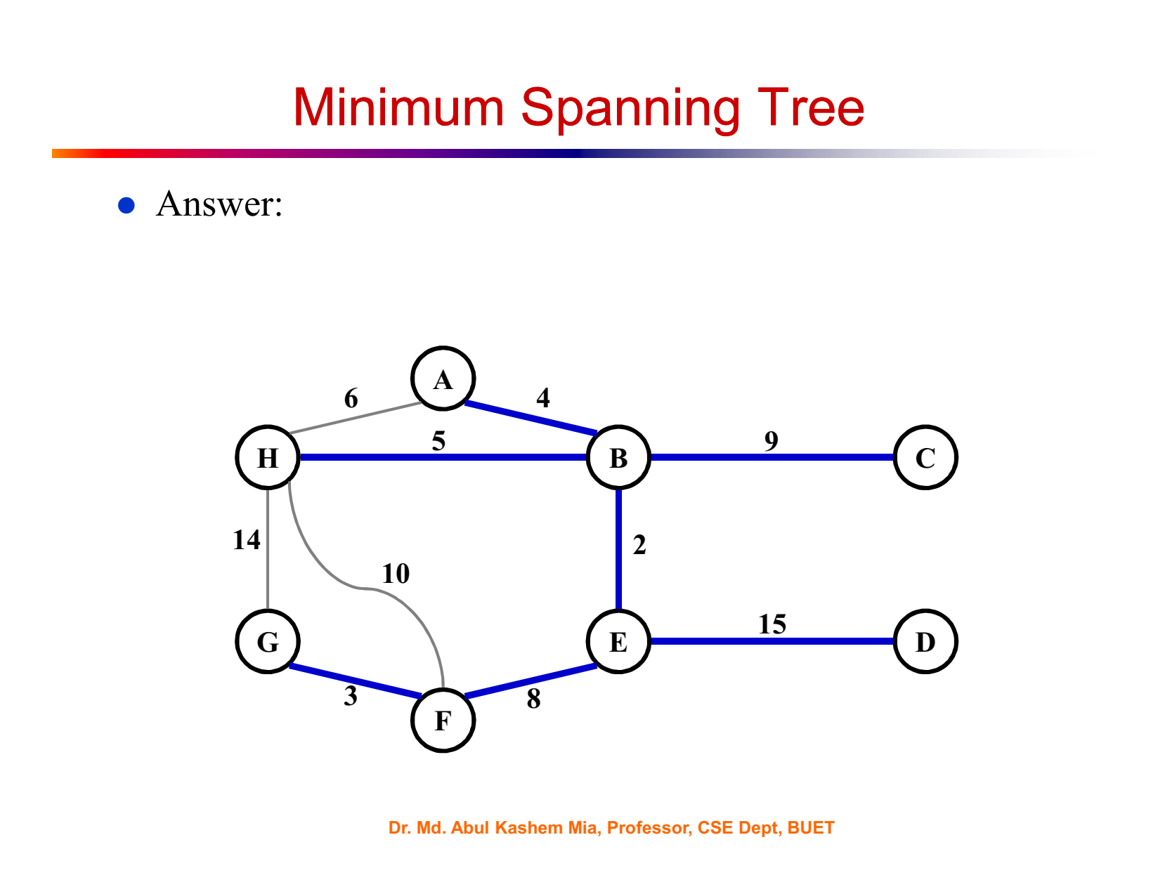

Slide 9
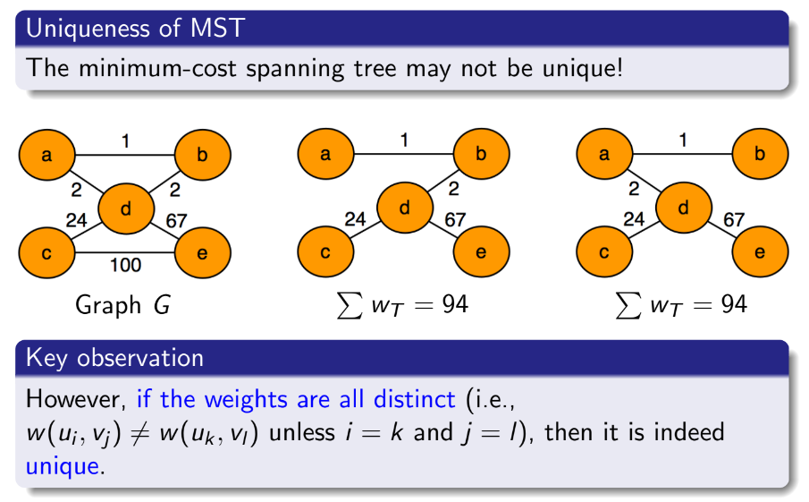

Slide 10
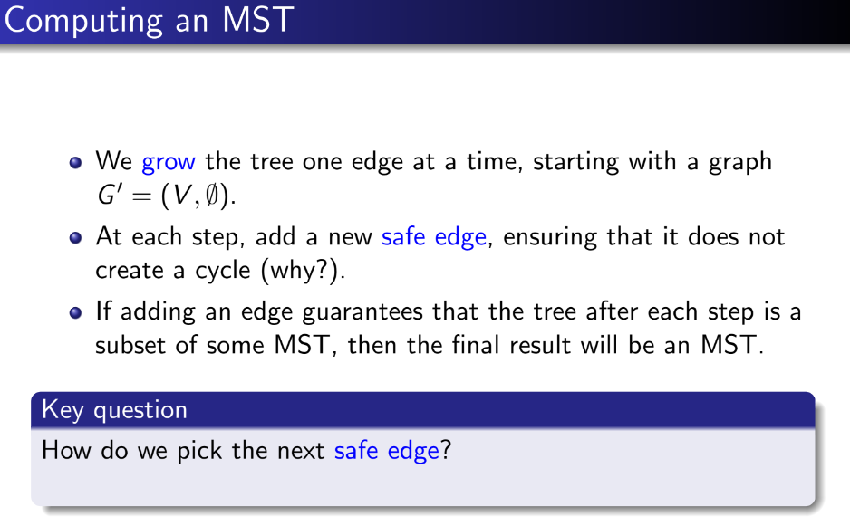

Slide 11
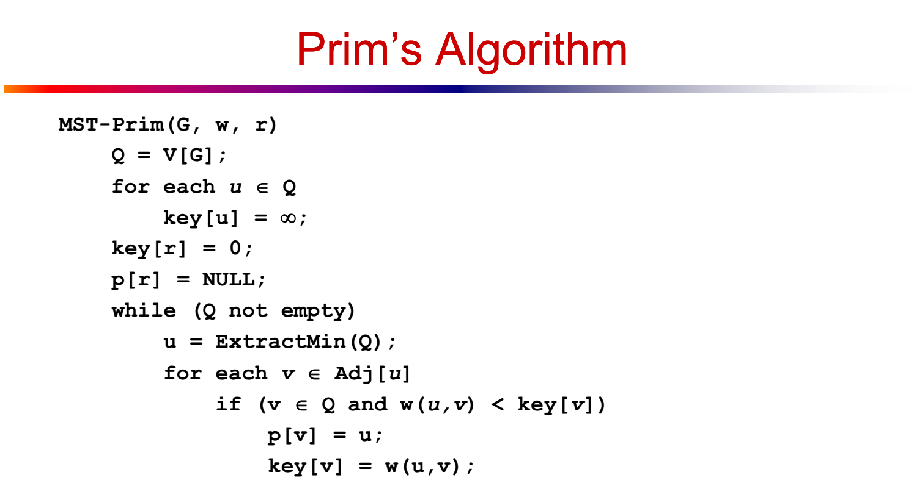

Slide 12
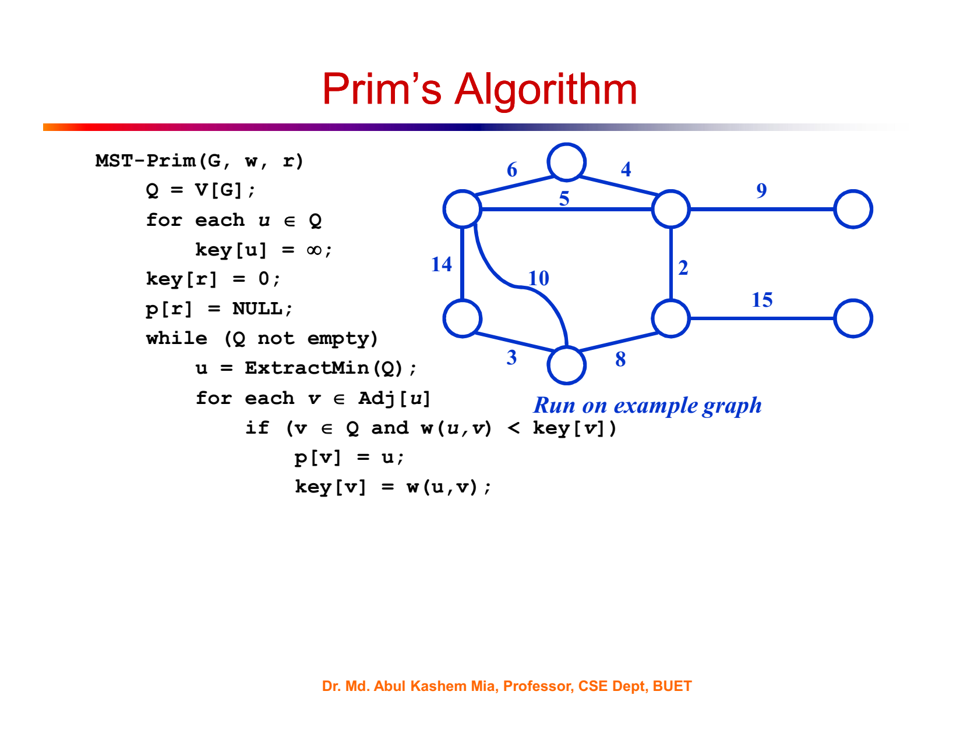

Slide 13


Slide 14
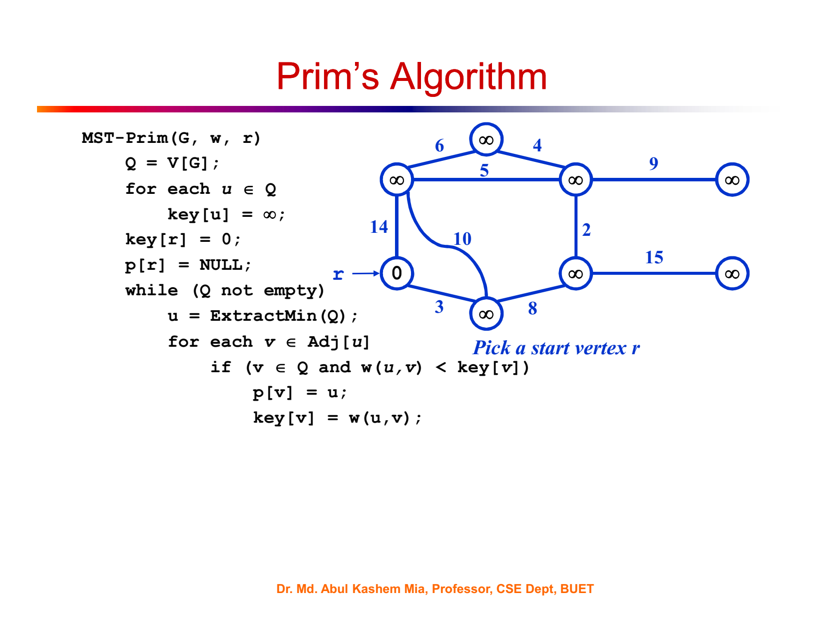

Slide 15
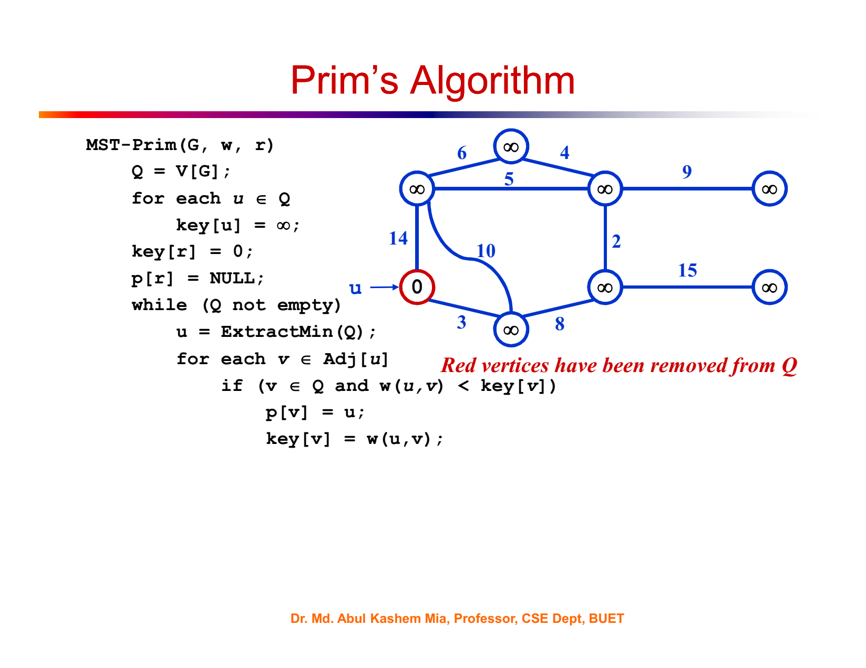

Slide 16


Slide 17
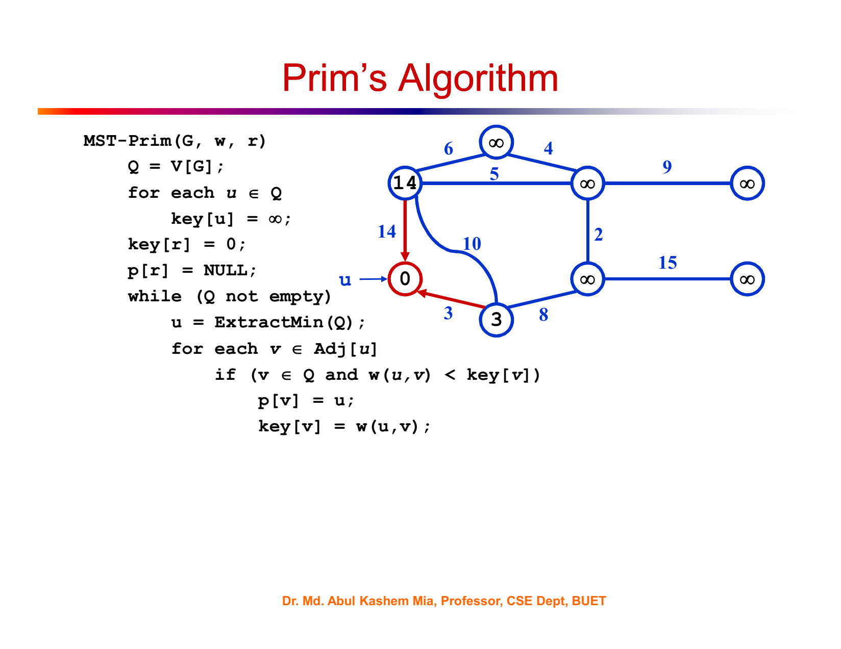

Slide 18
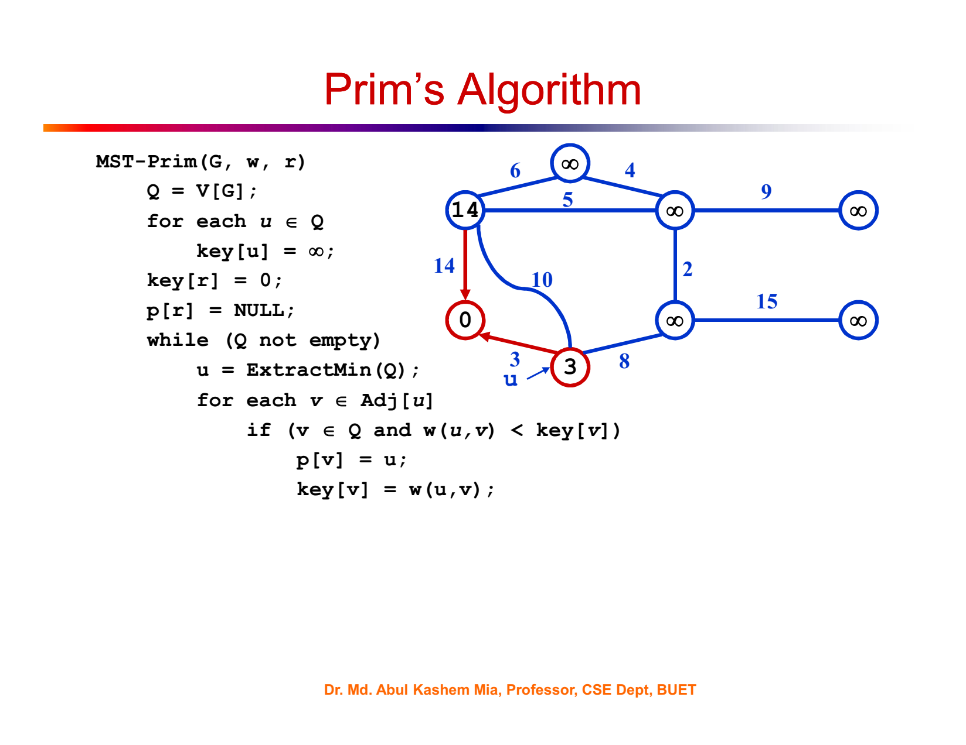

Slide 19
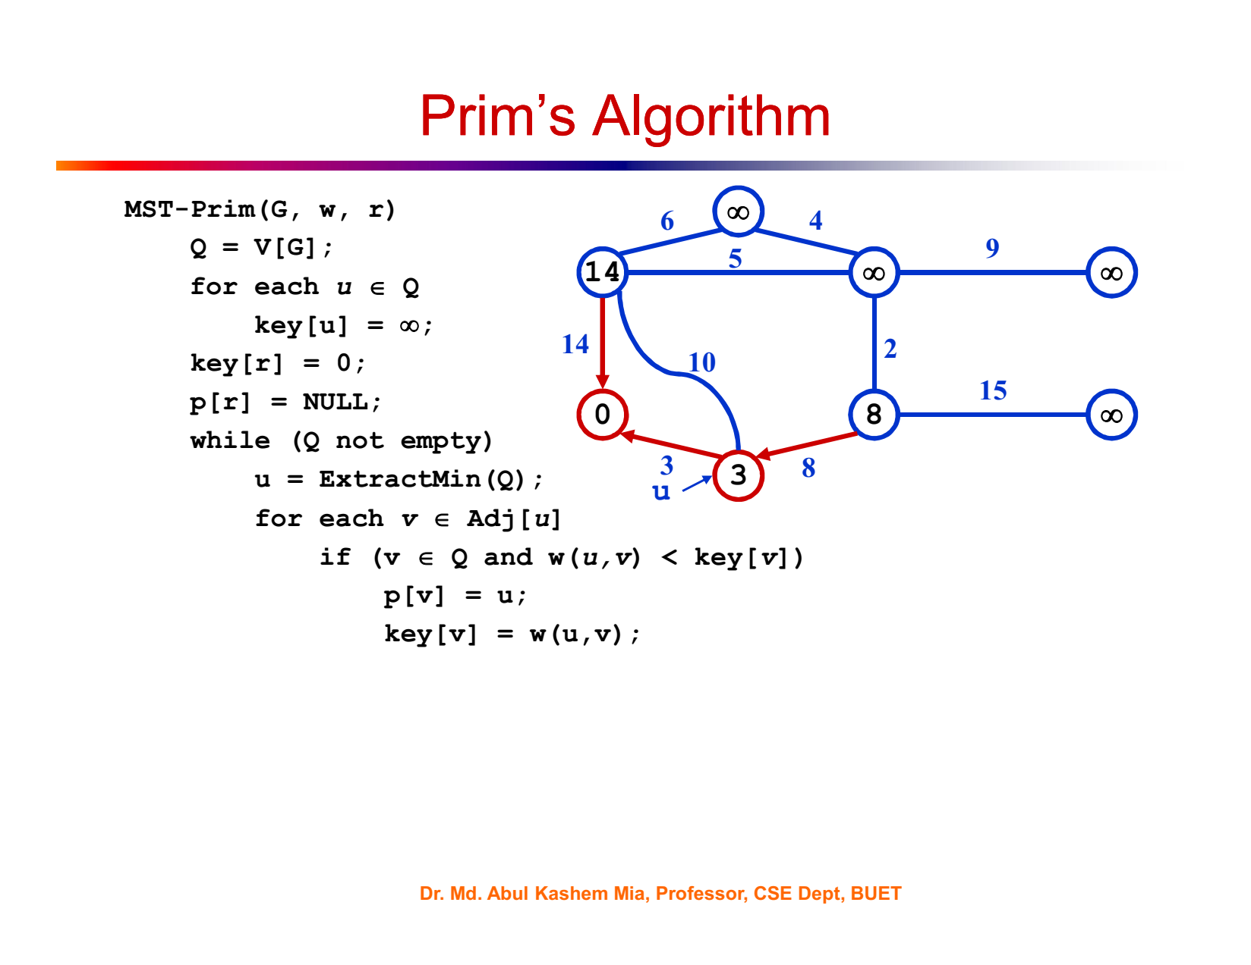

Slide 20
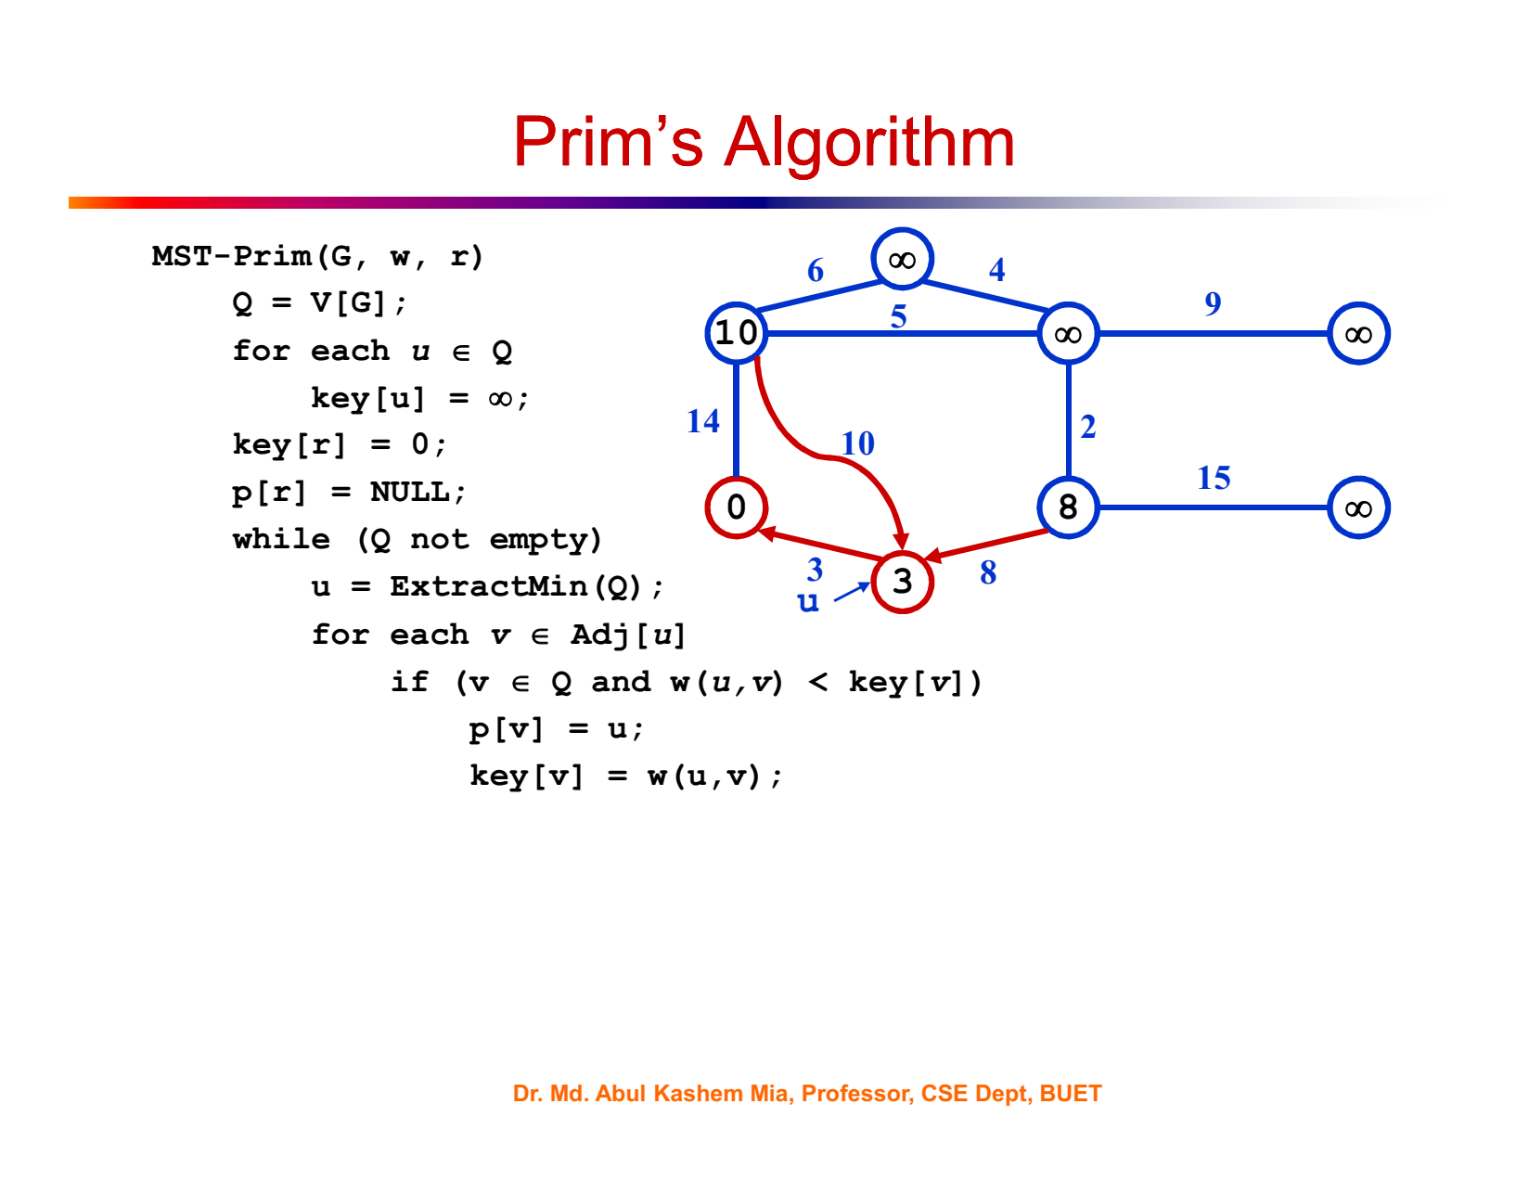

Slide 21
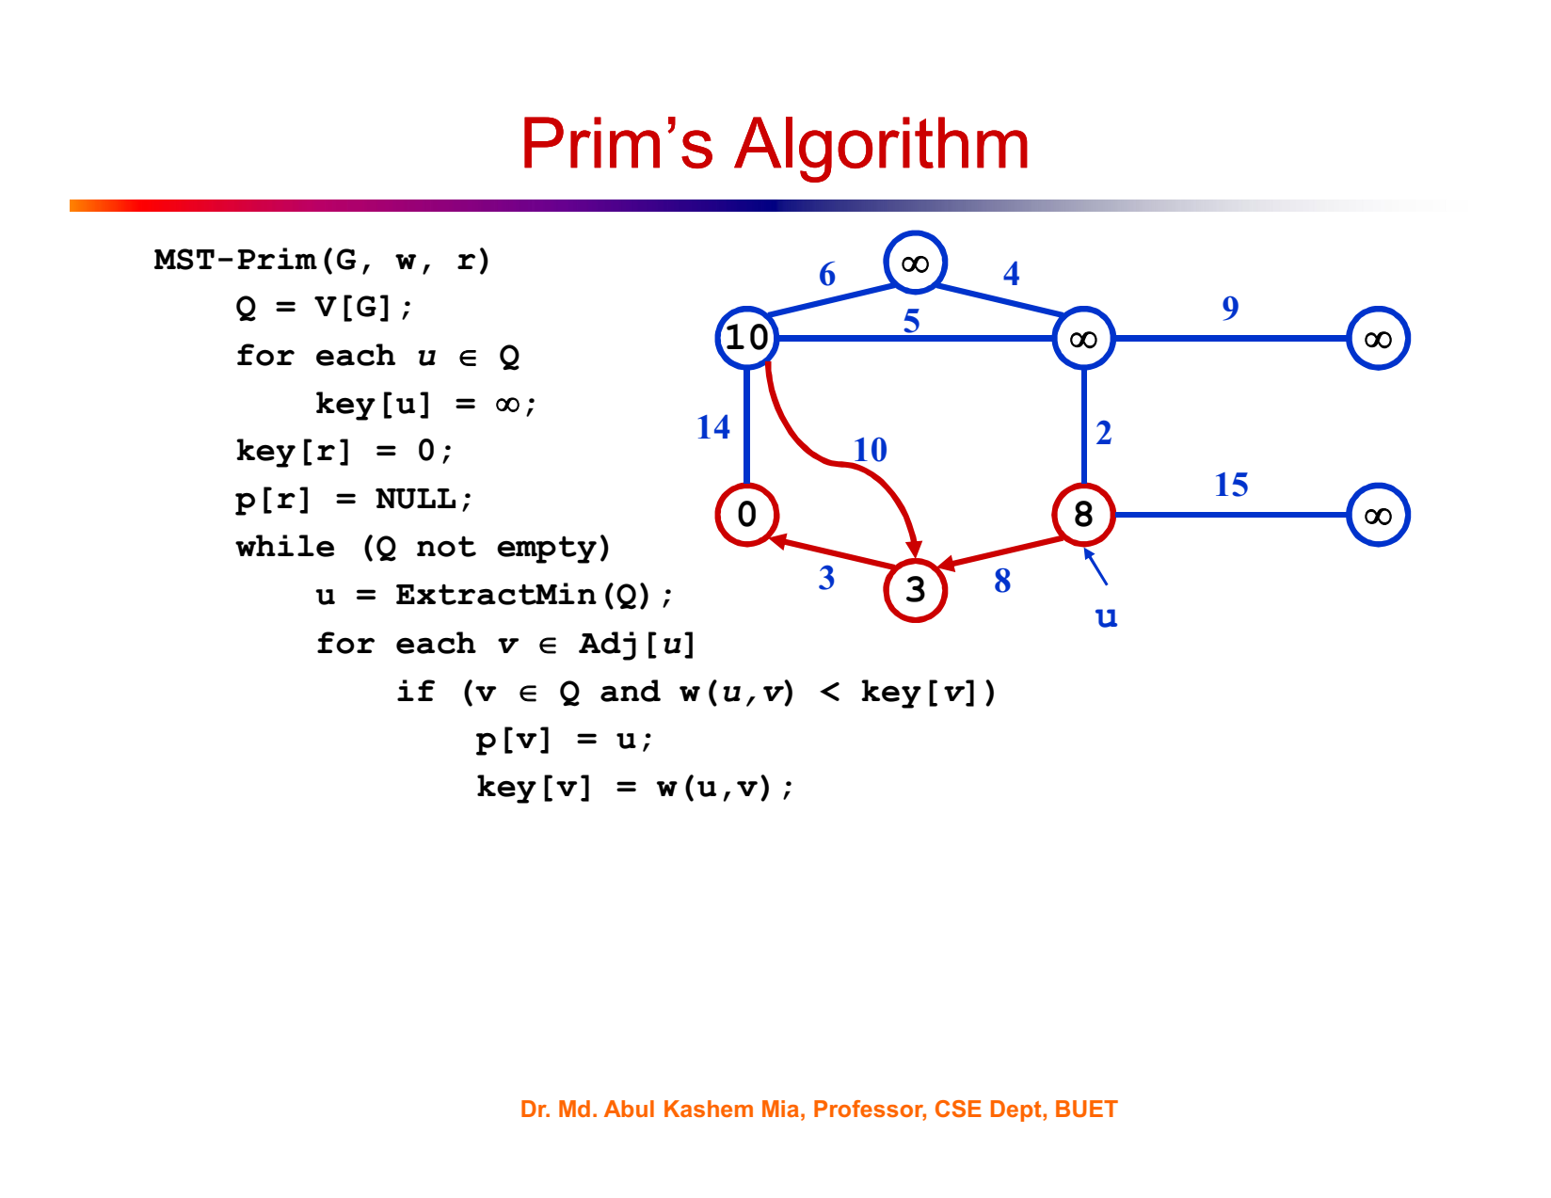

Slide 22
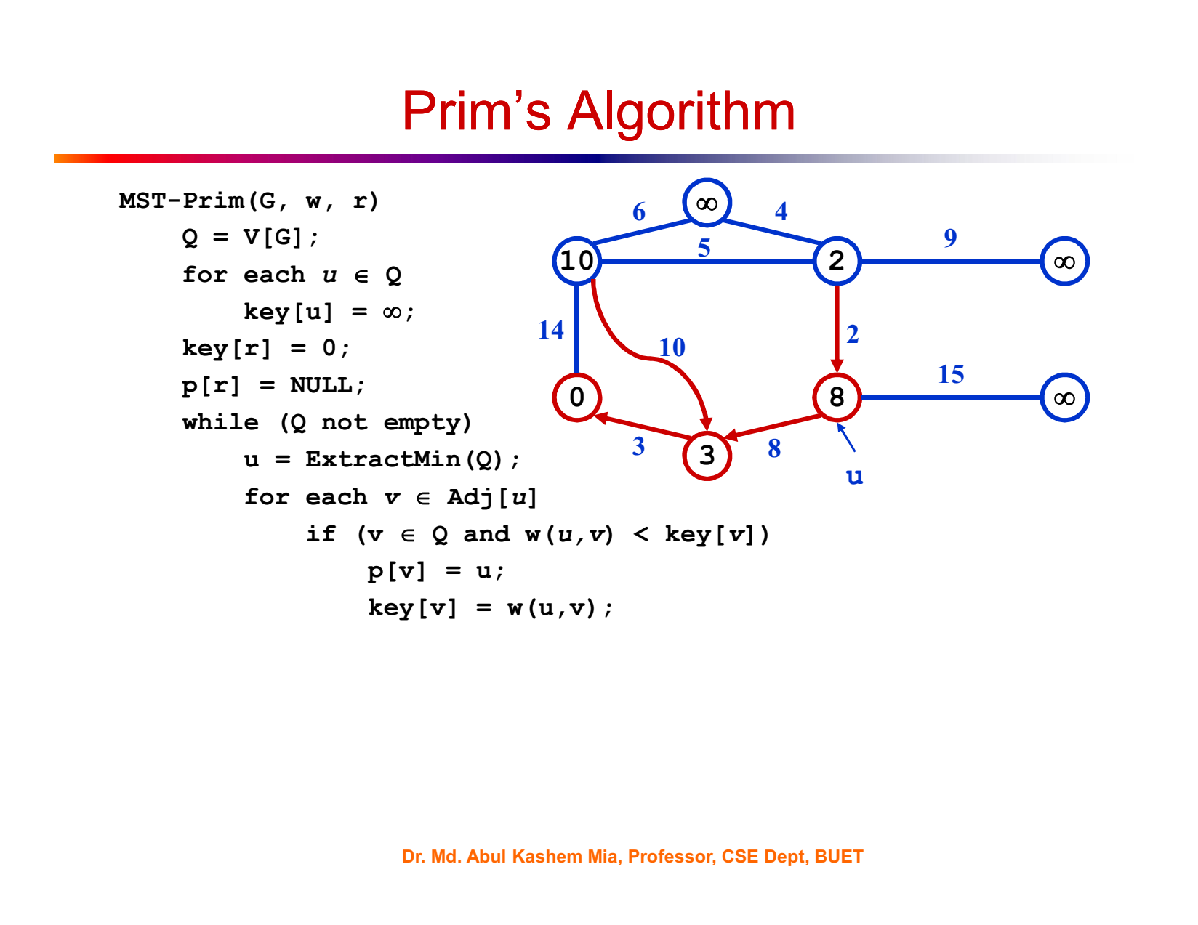

Slide 23


Slide 24
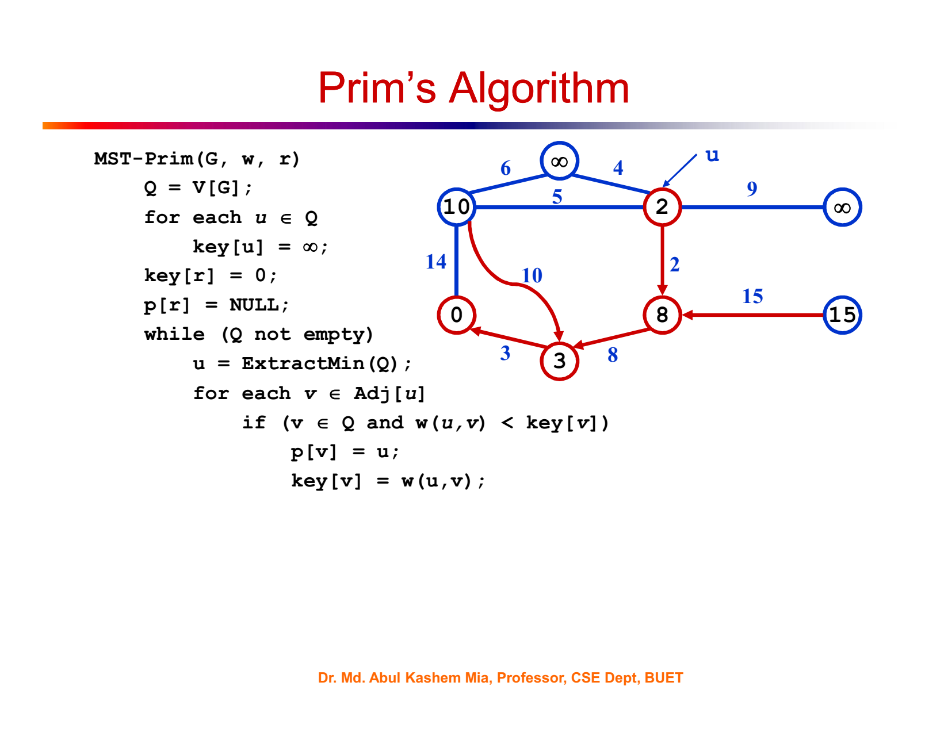

Slide 25
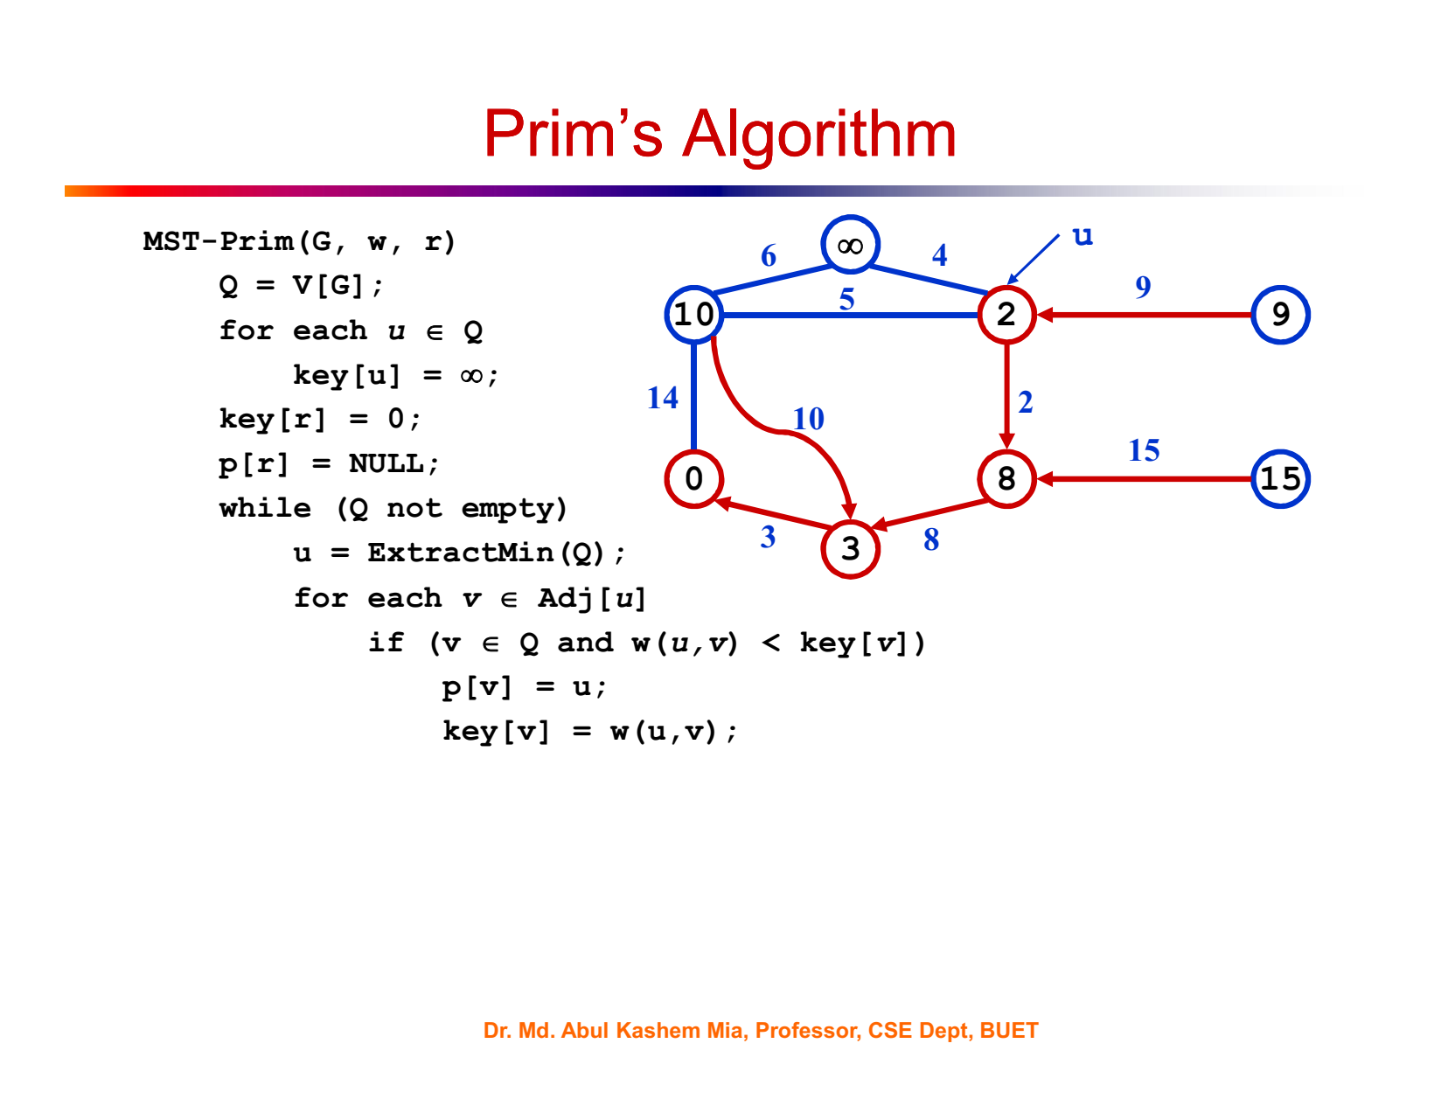

Slide 26


Slide 27
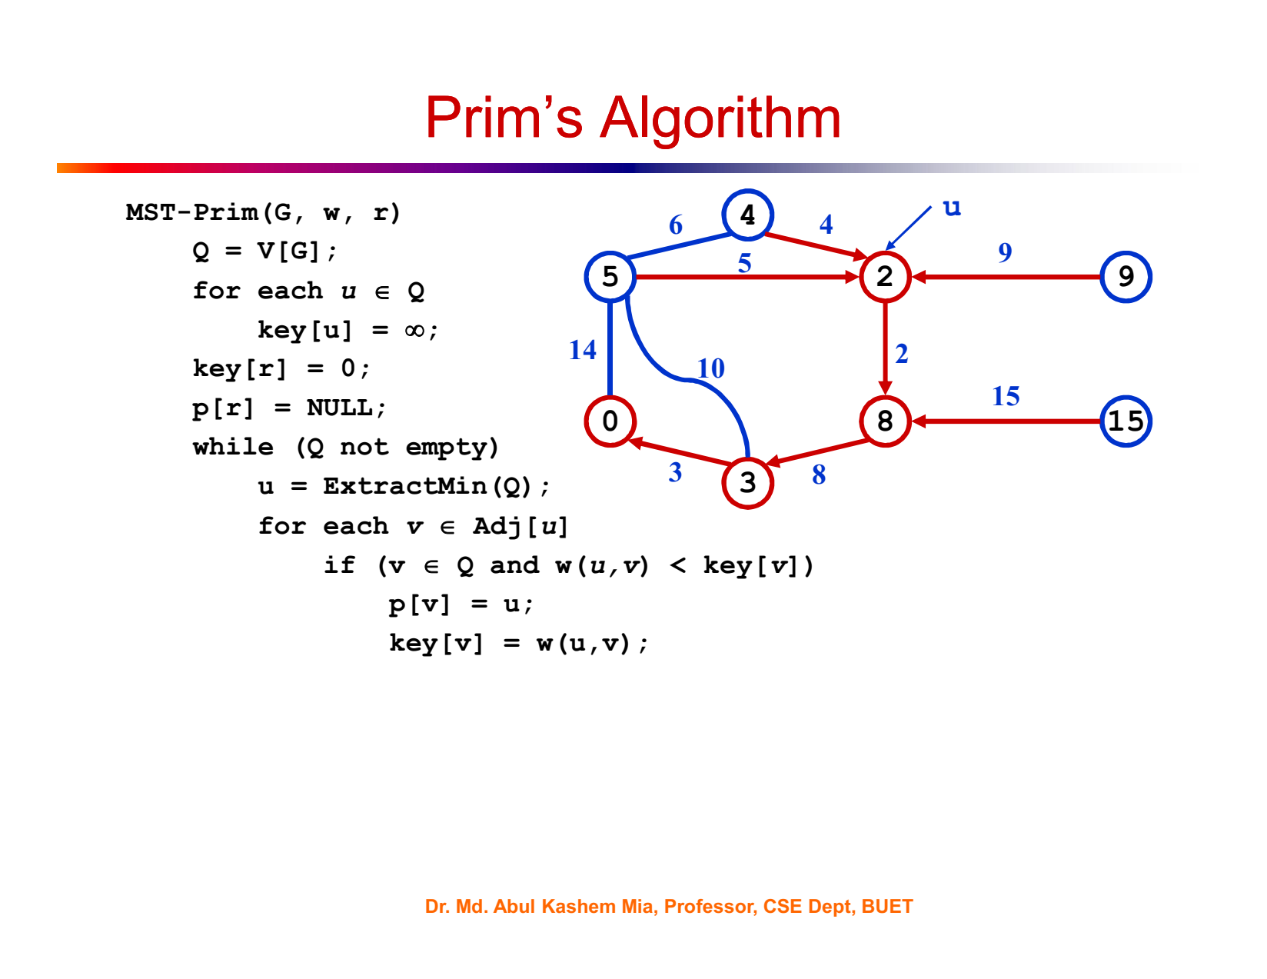

Slide 28
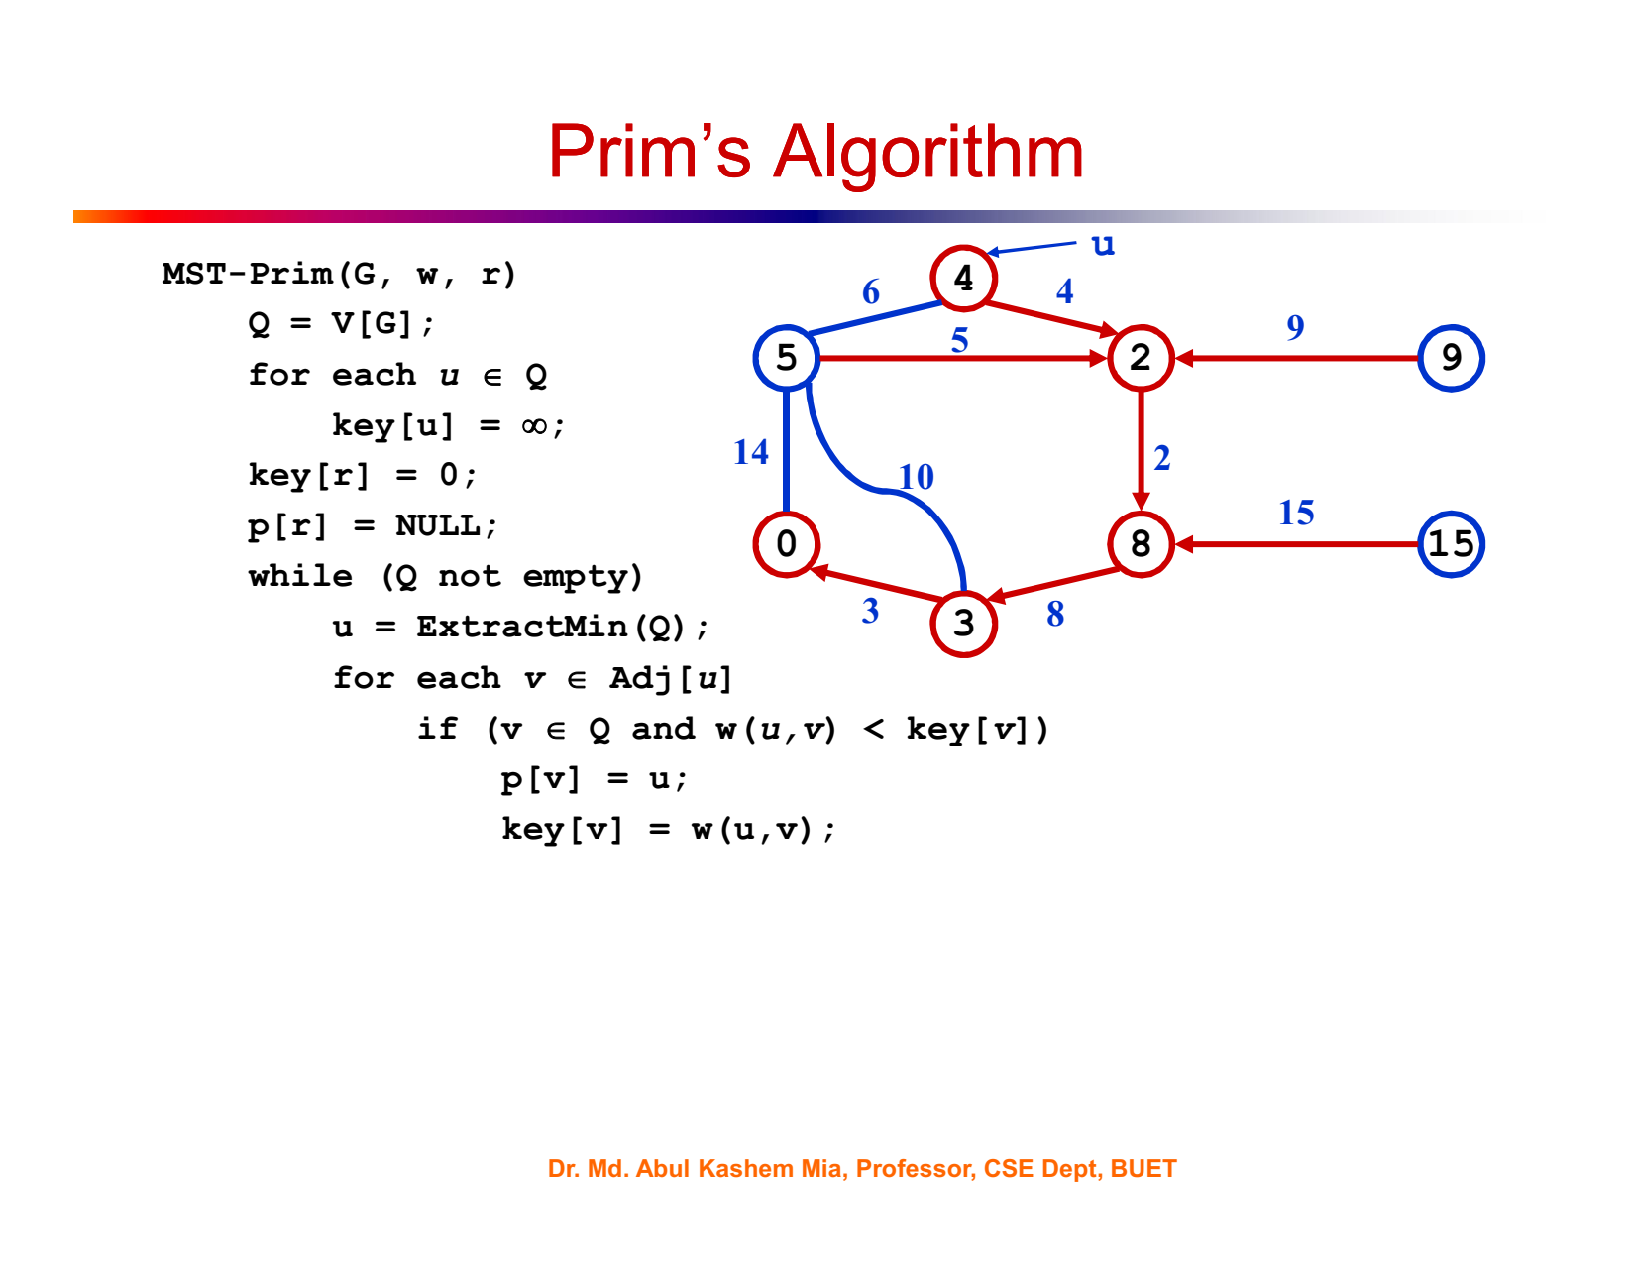

Slide 29
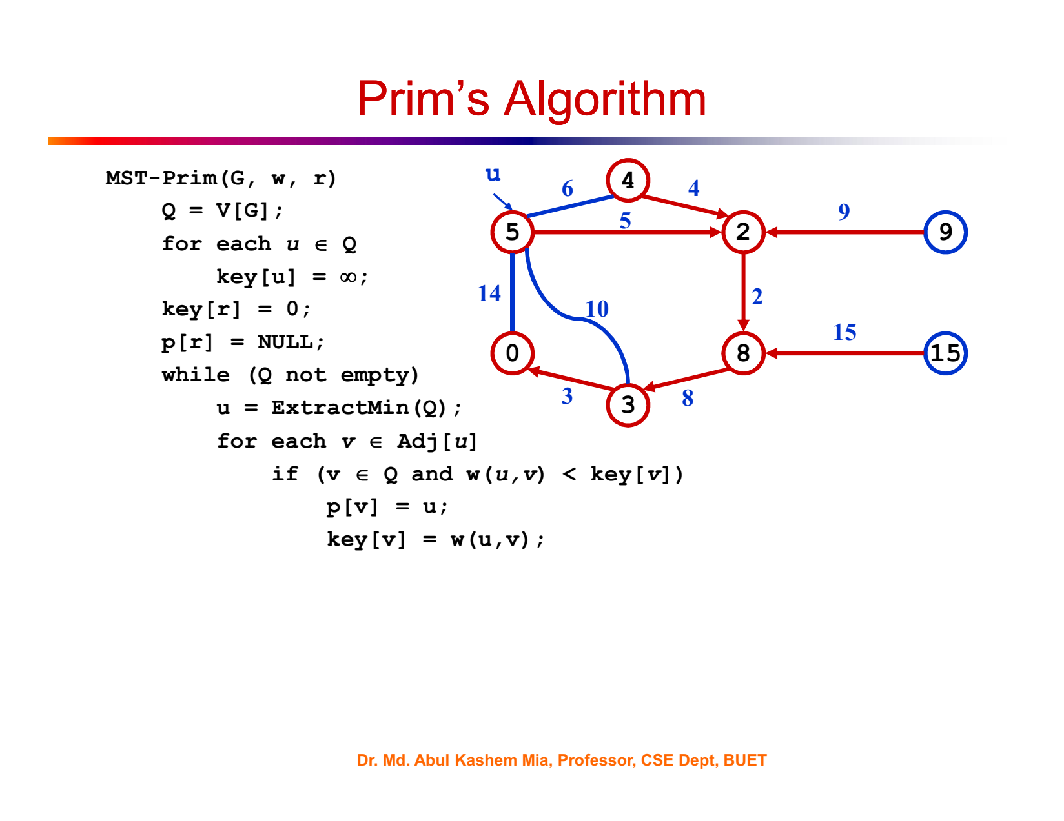

Slide 30
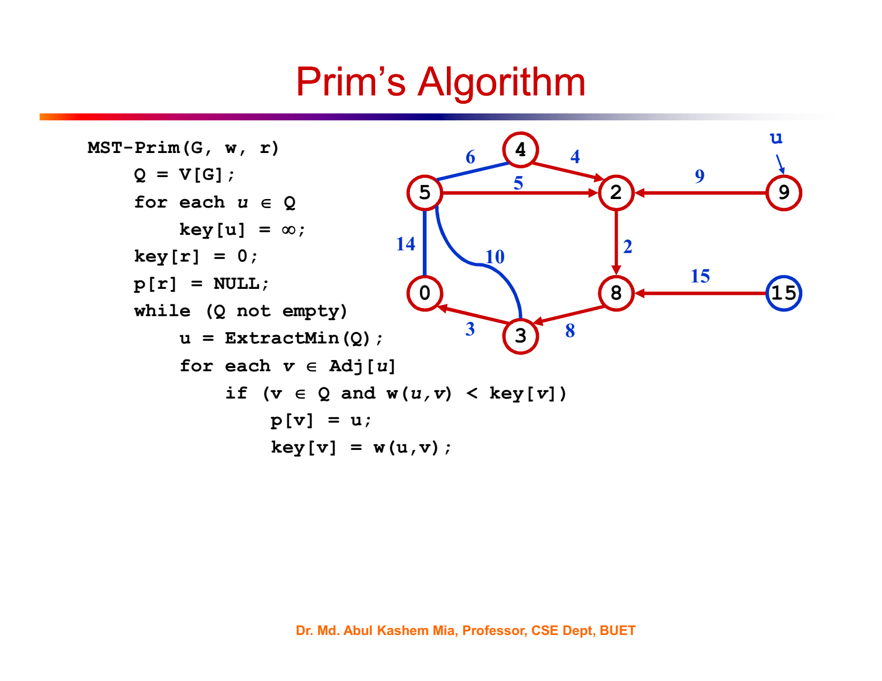

Slide 31
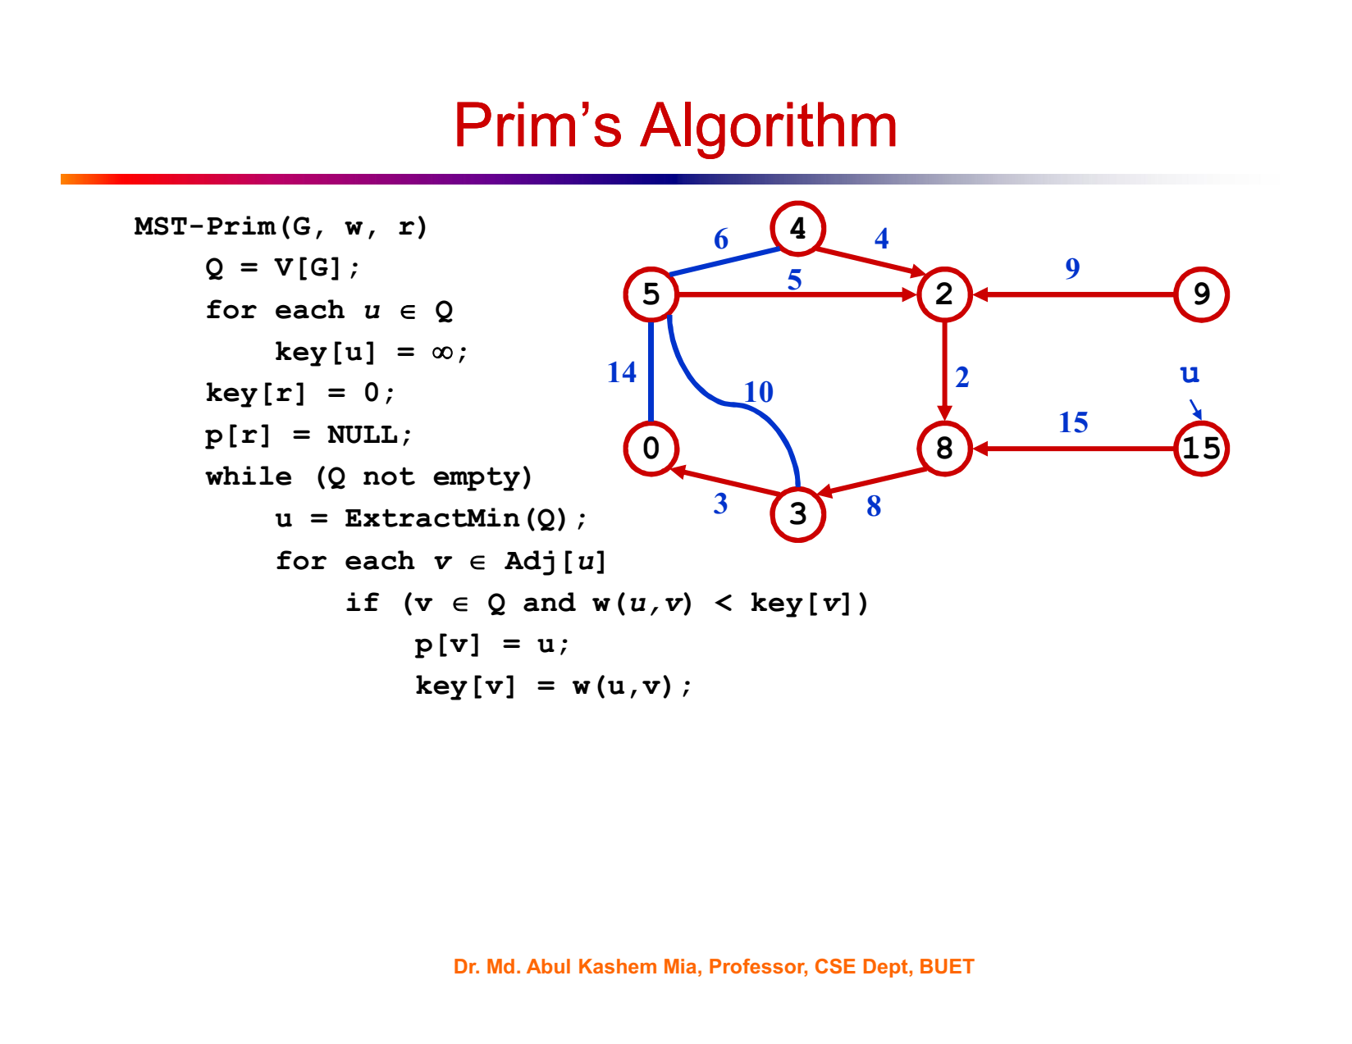

Slide 32
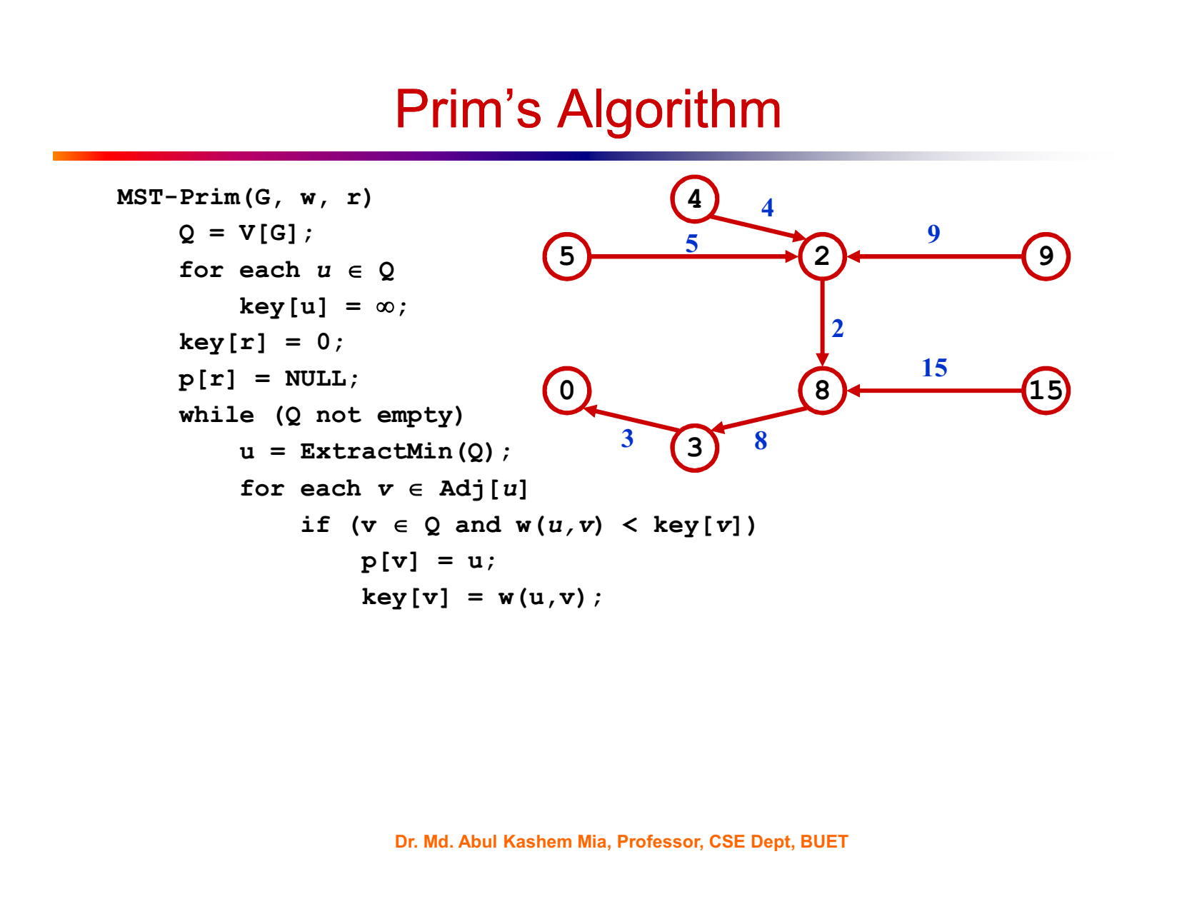

Slide 33
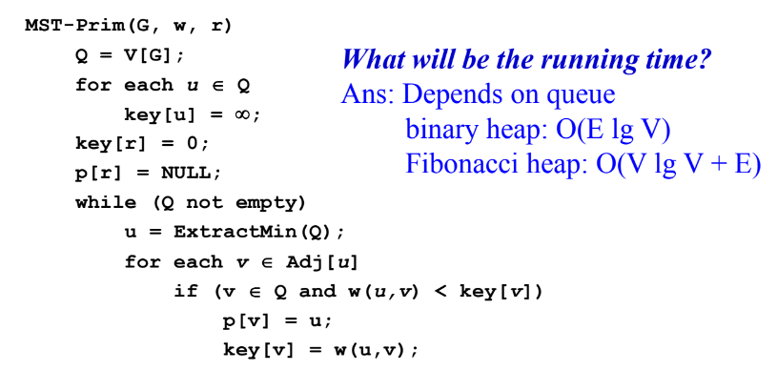

Slide 34
import heapq
def prim(graph):
# Select any starting vertex. For simplicity, we choose the first vertex in the graph.
start_vertex = list(graph.keys())[0]
# Keep track of visited vertices and the edges in the MST.
num_vertices = len(graph)
visited = [False] * num_vertices
mst_edges = []
# Initialize the priority queue with edges from the starting vertex.
priority_queue = [(weight, start_vertex, neighbor) for neighbor, weight in graph[start_vertex].items()]
heapq.heapify(priority_queue)
visited[start_vertex] = True
while priority_queue:
weight, vertex_from, vertex_to = heapq.heappop(priority_queue)
if not visited[vertex_to]:
visited[vertex_to] = True
mst_edges.append((vertex_from, vertex_to, weight))
for neighbor, neighbor_weight in graph[vertex_to].items():
if not visited[neighbor]:
heapq.heappush(priority_queue, (neighbor_weight, vertex_to, neighbor))
return mst_edges

Slide 35
Example usage of Prim's algorithm:
graph = {
'A': {'B': 1, 'C': 4},
'B': {'A': 1, 'C': 2, 'D': 5},
'C': {'A': 4, 'B': 2, 'D': 1},
'D': {'B': 5, 'C': 1}
}
mst = prim(graph)
print(mst)
# Output: [('A', 'B', 1), ('B', 'C', 2), ('C', 'D', 1)]

Slide 36
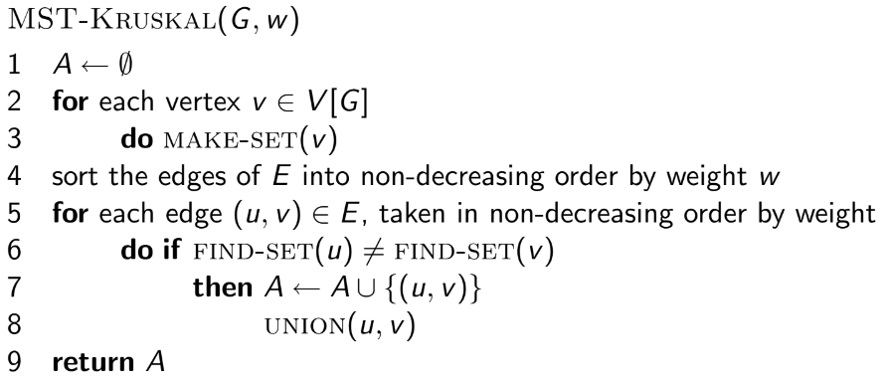
Kruskal’s algorithm
Time complexity: O(E log E)

Slide 37
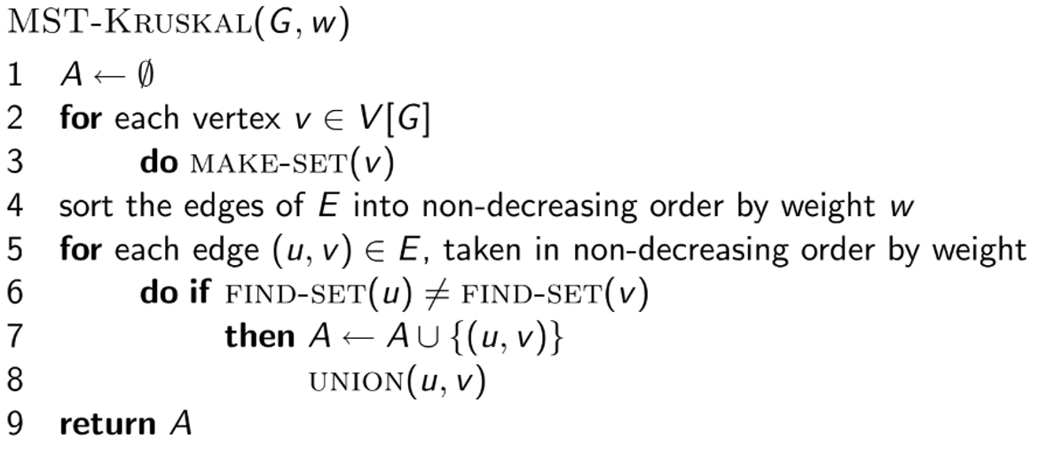
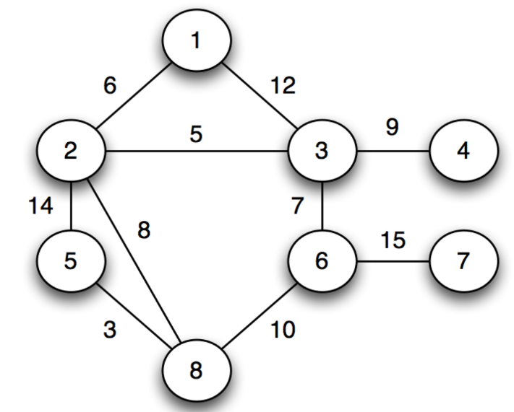
Kruskal’s algorithm

Slide 38
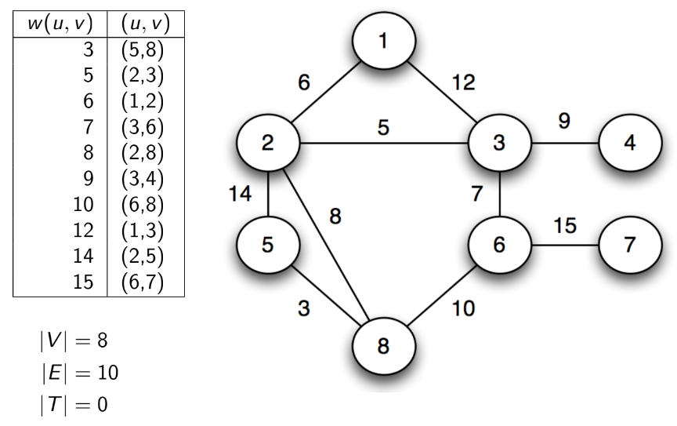
Kruskal’s algorithm

Slide 39
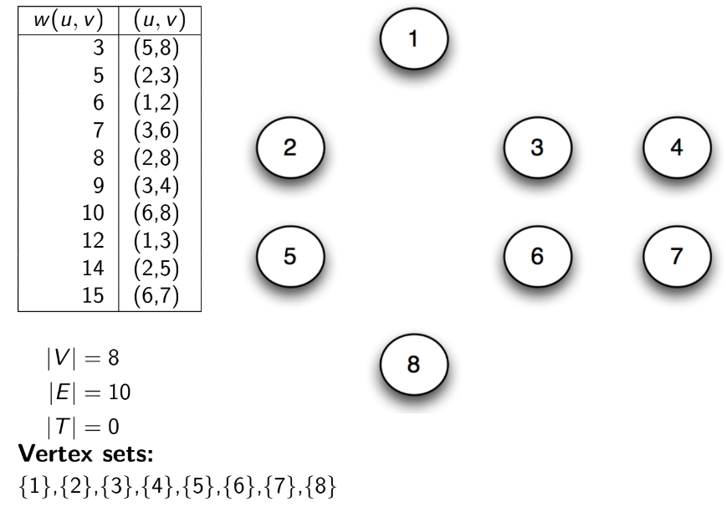
Kruskal’s algorithm

Slide 40
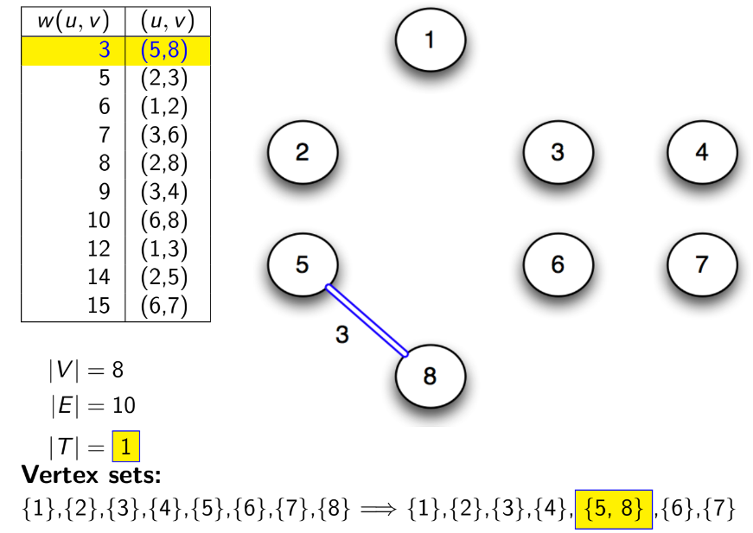
Kruskal’s algorithm

Slide 41
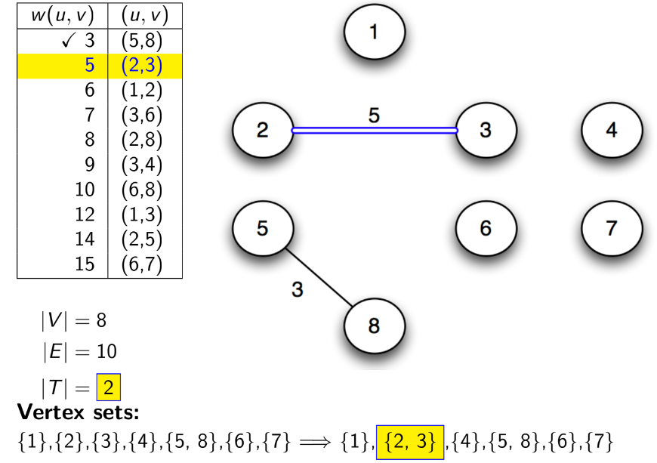
Kruskal’s algorithm

Slide 42
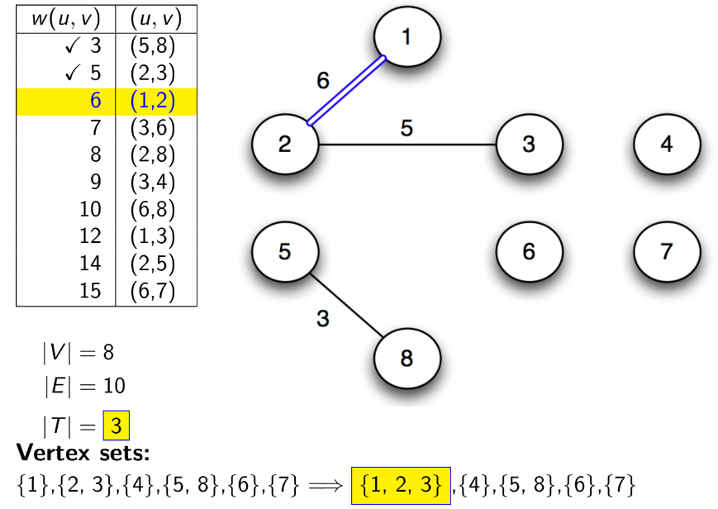
Kruskal’s algorithm

Slide 43
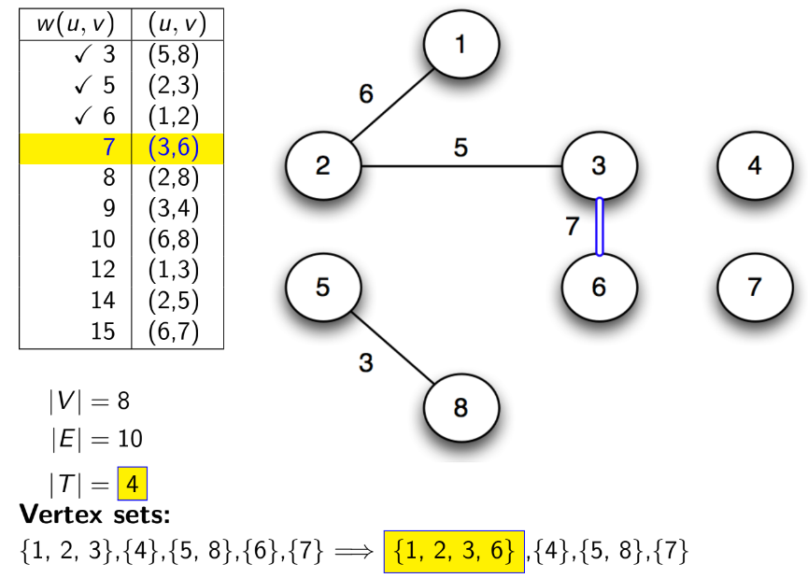
Kruskal’s algorithm

Slide 44
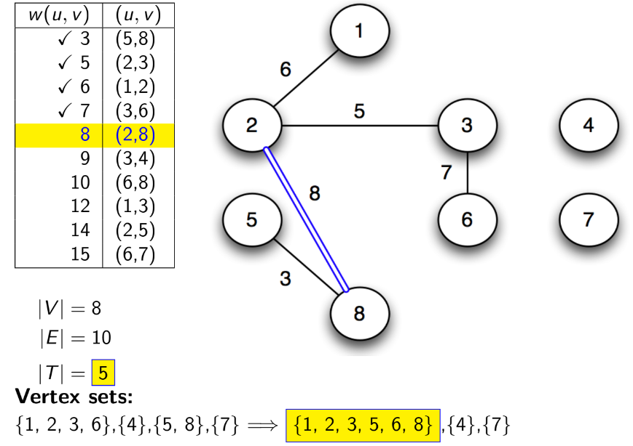
Kruskal’s algorithm

Slide 45
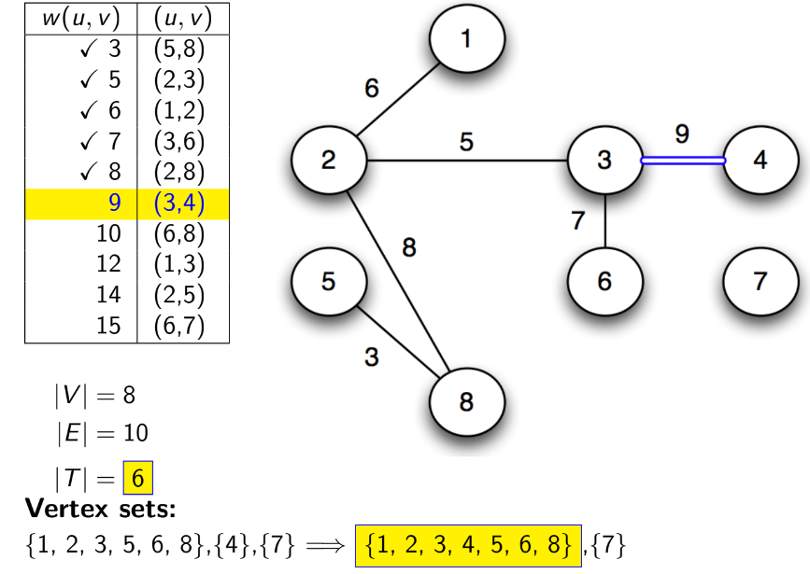
Kruskal’s algorithm

Slide 46
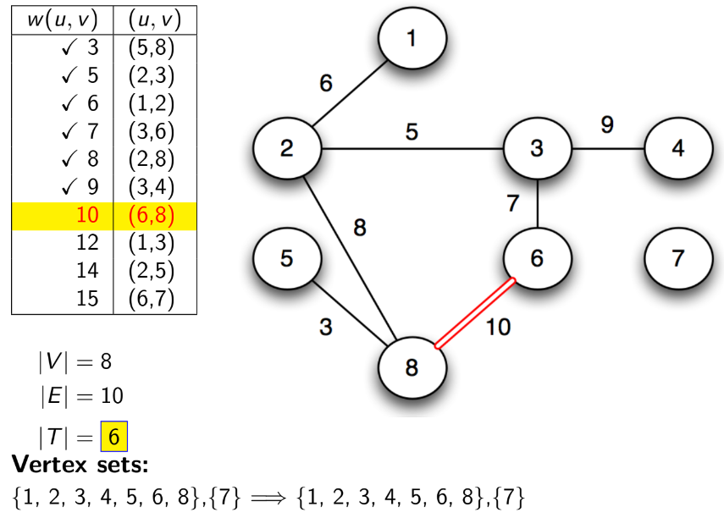
Kruskal’s algorithm

Slide 47
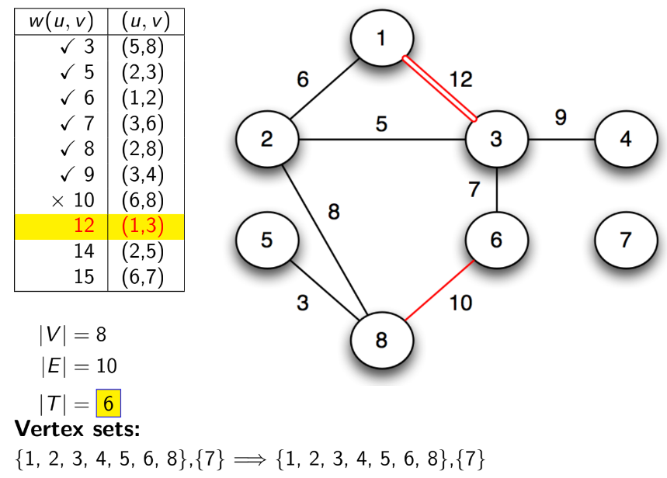
Kruskal’s algorithm

Slide 48
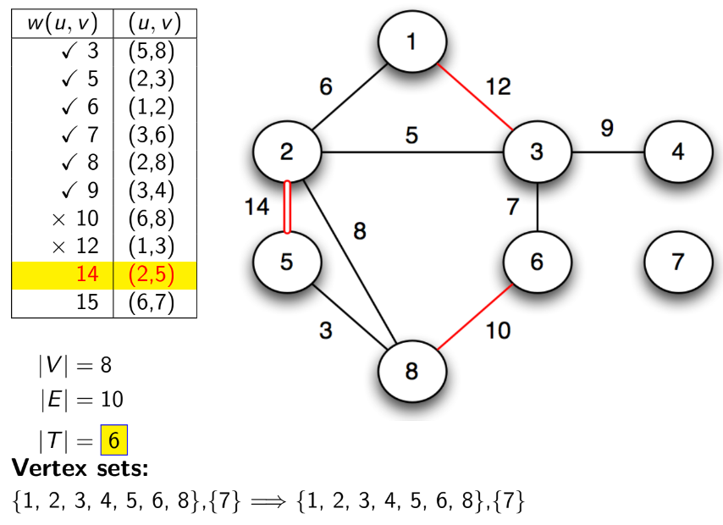
Kruskal’s algorithm

Slide 49
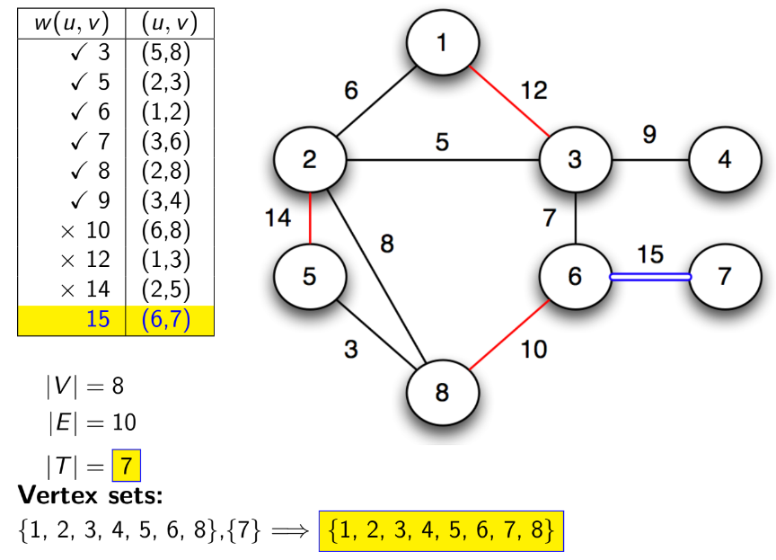
Kruskal’s algorithm

Slide 50
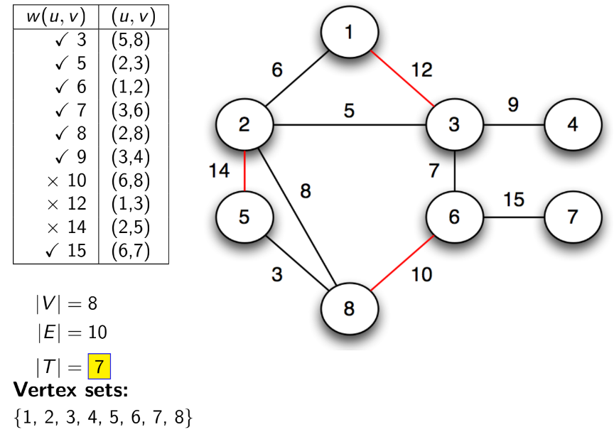
Kruskal’s algorithm

Slide 51
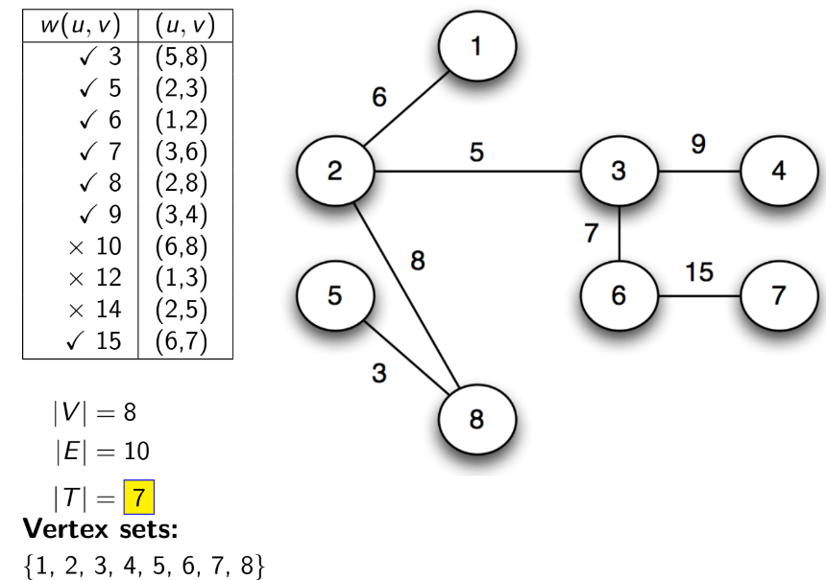
Kruskal’s algorithm

Slide 52
Kruskal’s algorithm

Slide 53
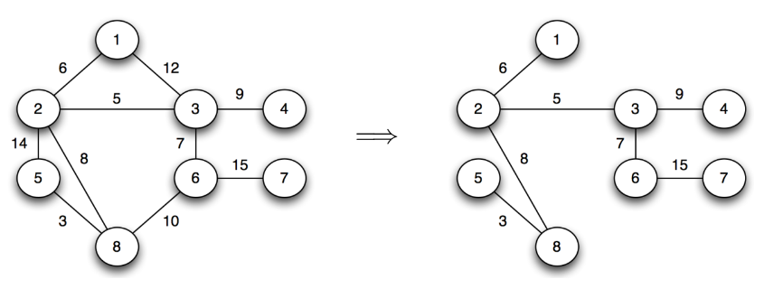
Kruskal’s algorithm

